Slide 1
Self Join
Example with Acme Employee Table

Slide 2
Self Join
For Unary relations with recursive FKs.
Managers, Supervisors, Mentors.
select e.Lastname as 'Employee', e.empno as 'Employee No', e.mgrno as 'Manager No', m.lastname as 'Manager Name'
from employee e
left join employee m
on m.empno = e.mgrno
order by e.mgrno
--compare
select Lastname as 'Employee', empno as 'Employee No', mgrno as 'Manager'
from employee
--where mgrno is not null
order by mgrno

Slide 3
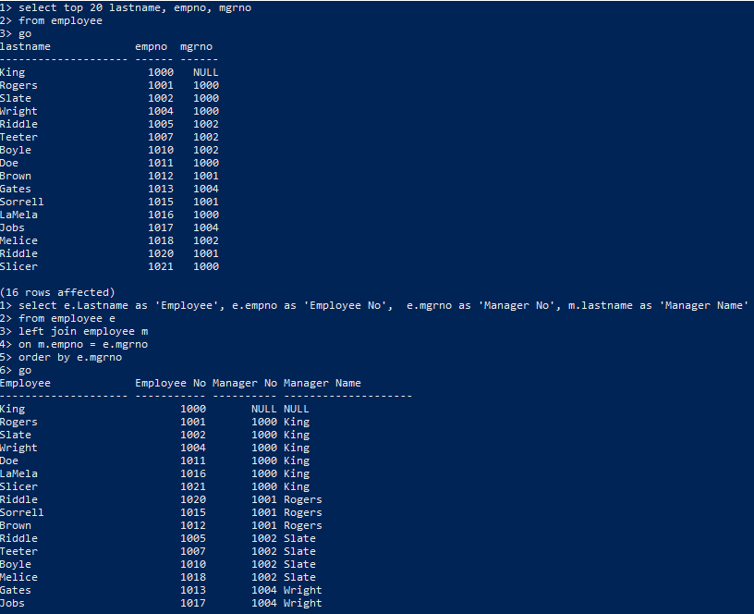
You can run it real quick in CMD to test
Employee by name, number and manager number
Employee by name, number and manager number with
manager’s name

